Slide 1
Standard Form
Jamie Jowett

Slide 2
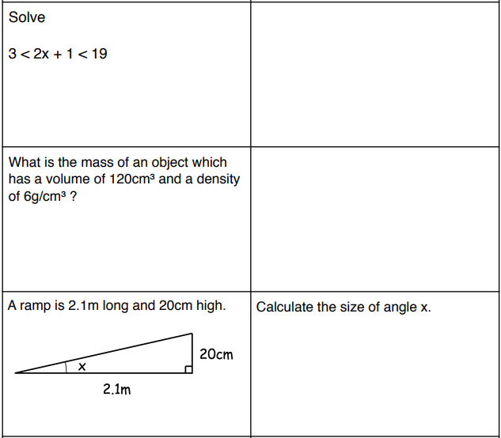
Starter

Slide 3
Learning Objectives
Grades 3-4
Convert large and small numbers into standard form and vice versa;
Interpret a calculator display using standard form and know how to enter numbers in standard form.
Grade 5
Add, subtract, multiply and divide numbers in standard form, with and without a calculator

Slide 4
What is Standard form ?
Standard form is a way of writing really big or really small numbers in a shorter format.
For example the number 9,100,000,000,000,000 can also be written in the format 9.1 X 10¹⁵
Standard form is always in this set up
n X 10^{x}
Where n is a number between 1 and 9.99999…
And x is a whole number that is positive or negative
Likewise the number 0.0000000342 can also be written in the format 3.42 X 10⁻⁸

Slide 5
Convert to standard form big and small
One of the most common types of questions you will get with standard form is being able to convert in and out of it.
To Convert into standard form we need to move the DECIMAL POINT so that we make a number between 1 and 9.9999 …
Lets say we are given this number and we need to convert it.
So the correct answer is
8.72 X 10⁵
872000
.
.
Where is the decimal point right now ?
At the end of the number right. So now we need to move it to a place that makes this number be between 1 and 9.9999 …
So now my number reads as 8.72
The last step is to X 10 and put in the correct power … and the power is how many jumps we did

Slide 6
Convert to standard form big and small
It’s the exact same thing with small numbers too, just don’t forget to put a – with you power …
Don’t forget the - !!!
Lets say we are given this number and we need to convert it.
So the correct answer is
1.44 X 10⁻⁴
0.000144
.
Where is the decimal point right now ?
Its already there. So now we need to move it to a place that makes this number be between 1 and 9.9999 …
So now my number reads as 1.44
The last step is to X 10 and put in the correct power … and the power is how many jumps we did
6

Slide 7
Your Turn
Convert these 2 numbers into Standard Form
1925000
0.000862
1.925 X 10⁶
8.62 X 10⁻⁴

Slide 8
Convert out of standard form big and small
Converting in and out of standard form is very similar but we just do it in the reverse order …
Lets say we have this number
2.0314 X 10⁻⁶
So now my number reads as
000.0000020314 or 0.0000020314
.
2.0314
00000000
As I have a – power I know the number will be getting smaller … so its going to be a really small decimal …
As the number is getting smaller I know the decimal is going to move forward so I'm going to put a heap of 0’s in front so I can move the decimal … it doesn’t matter if I put too many as I can just ignore them …
I can now move the decimal

Slide 9
Your Turn
Convert these 2 Standard Form into normal numbers
6.112 X 10⁻⁵
4.327 X 10⁷
0.00006112
43270000

Slide 10
Add and subtract numbers in standard form
To add or subtract numbers in standard form we have to expand them into normal numbers and then simply add/subtract them then convert back…
2.031 X 10⁴
+
5.11 X 10⁶
=
+
=
20310
5110000
5130310
.
5130310
.
So my answer is
5.130310 X 10⁶

Slide 11
Multiply and Divide numbers in standard form
If it was divide we would take away the powers !!! Just be careful for double negatives !!!
To multiply and divide with standard form it’s a little bit simpler.
I can do the number times/divide the other number and then I can use the LAWS OF INDICES with the 10^{x} ‘s
2.031 X 10⁴
X
5.11 X 10⁶
=
As bottoms are the same and we are X we can add the powers together
2.031 X 5.11 = 10.37841
10⁴ X 10⁶ =
10¹⁰
Is this my answer ?
10.37841 X 10¹⁰
No, as its not between 1 and 10
1.037841 X 10¹¹

Slide 12
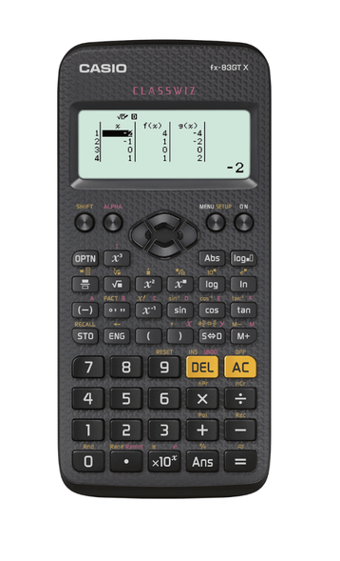
Using a Calculator
Just a quick heads up before I set you off.
With a calculator, most of the time you can type these in but to speed it up you need to know this button, which does the X10 and sets up to type the power in.
Often when you do big calculations you will get your answer in the format … so now hopefully you know what this means
These questions come up on both calculator and Non calculator so you need to know how to do it without.

Slide 13
Workbooks
Please now have a go at the workbooks.
You'll have 30 minutes and then I’ll start going through some answers.
Workbook link;-
https://corbettmaths.com/wp-content/uploads/2022/10/Standard-Form.pdf

Slide 14
Answers
Answers link;-
https://corbettmaths.com/wp-content/uploads/2022/10/Standard-Form-Answers.pdf

Slide 15
Learning Objectives
Grades 3-4
Convert large and small numbers into standard form and vice versa;
Interpret a calculator display using standard form and know how to enter numbers in standard form.
Grade 5
Add, subtract, multiply and divide numbers in standard form, with and without a calculator
✔
✔
✔

Slide 16
Thank You
Email;- jjowett@coventrycollege.ac.uk

